Slide 1

Introduction To Microprocessor
Module 2
  GLA UNIVERSITY Mathura, Uttar Pradesh, India

Slide 2
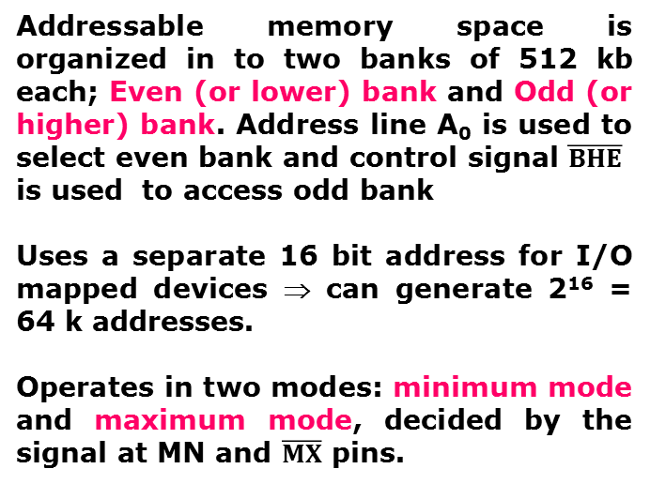
Overview
8086 Microprocessor
First 16- bit processor released by INTEL in the year 1978
Originally HMOS, now manufactured using HMOS III technique
Approximately 29, 000 transistors, 40 pin , 5V supply
Does not have internal clock; external asymmetric clock source with 33% duty cycle
20-bit address to access memory ⇒ can address up to 2²⁰ = 1 megabytes of memory space.
Addressable memory space is organized in to two banks of 512 kb each; Even (or lower) bank and Odd (or higher) bank. Address line A₀ is used to select even bank and control signal $\overline{BHE}$
is used to access odd bank
Uses a separate 16 bit address for I/O mapped devices ⇒ can generate 2¹⁶ = 64 k addresses.
Operates in two modes: minimum mode and maximum mode, decided by the signal at MN and $\overline{MX}$ pins.
Notes:
DIP- Dual Inline Package

Slide 3
Pins and signals

Slide 4
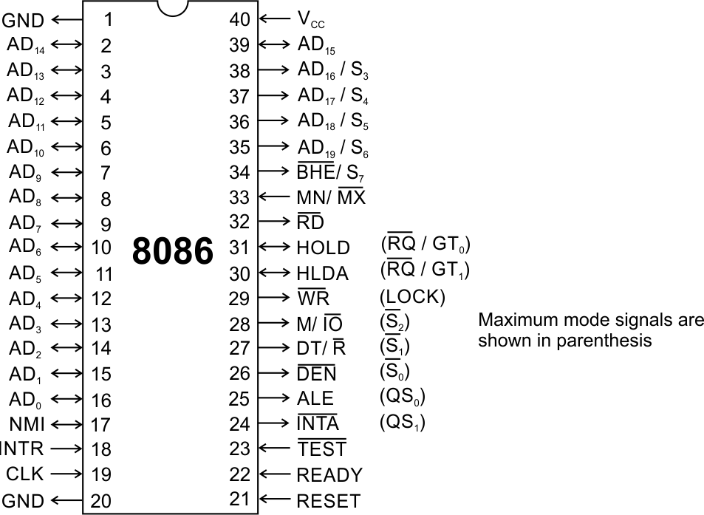
Pins and Signals
8086 Microprocessor
Common signals
AD₀-AD₁₅ (Bidirectional)
Address/Data bus
Low order address bus; these are multiplexed with data.
When AD lines are used to transmit memory address the symbol A is used instead of AD, for example A₀-A₁₅.
When data are transmitted over AD lines the symbol D is used in place of AD, for example D₀-D₇, D₈-D₁₅ or D₀-D₁₅.
A₁₆/S₃, A₁₇/S₄, A₁₈/S₅, A₁₉/S₆
High order address bus. These are multiplexed with status signals

Slide 5
Pins and Signals
8086 Microprocessor
Common signals
BHE (Active Low)/S₇ (Output)
Bus High Enable/Status
It is used to enable data onto the most significant half of data bus, D₈-D₁₅. 8-bit device connected to upper half of the data bus use BHE (Active Low) signal. It is multiplexed with status signal S₇.
MN/ MX (Active Low)
MINIMUM / MAXIMUM
This pin signal indicates what mode the processor is to operate in.
RD (Read) (Active Low)
The signal is used for read operation.
It is active when low.

Slide 6
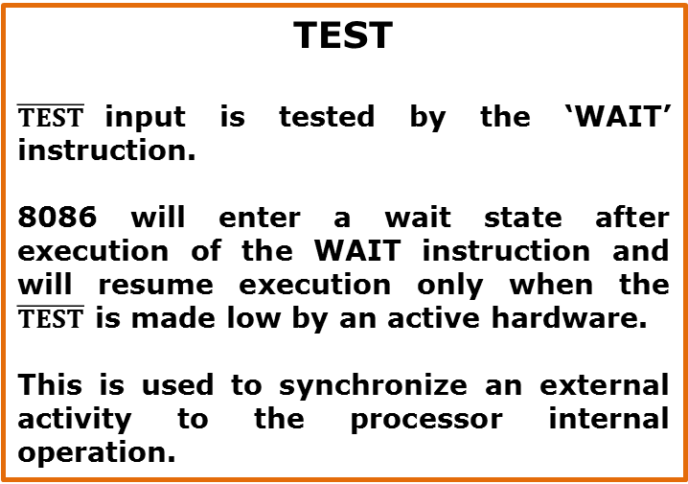
Pins and Signals
8086 Microprocessor
Common signals
TEST
$\overline{TEST}$input is tested by the ‘WAIT’ instruction.
8086 will enter a wait state after execution of the WAIT instruction and will resume execution only when the $\overline{TEST}$ is made low by an active hardware.
This is used to synchronize an external activity to the processor internal operation.
READY
This is the acknowledgement from the slow device or memory that they have completed the data transfer.
The signal is active high.

Slide 7
Pins and Signals
8086 Microprocessor
Common signals
RESET (Input)
Causes the processor to immediately terminate its present activity.
The signal must be active HIGH for at least four clock cycles.
CLK
The clock input provides the basic timing for processor operation and bus control activity. Its an asymmetric square wave with 33% duty cycle.
INTR Interrupt Request
This is a triggered input. This is sampled during the last clock cycles of each instruction to determine the availability of the request. If any interrupt request is pending, the processor enters the interrupt acknowledge cycle.
This signal is active high and internally synchronized.

Slide 8
NMI
Non -Maskable Interrupt Request

Slide 9
Pins and Signals
8086 Microprocessor
Min/ Max Pins
The 8086 microprocessor can work in two modes of operations : Minimum mode and Maximum mode.
In the minimum mode of operation the microprocessor do not associate with any co-processors and can not be used for multiprocessor systems.
In the maximum mode the 8086 can work in multi-processor or co-processor configuration.
Minimum or maximum mode operations are decided by the pin MN/ MX(Active low).
When this pin is high 8086 operates in minimum mode otherwise it operates in Maximum mode.

Slide 10


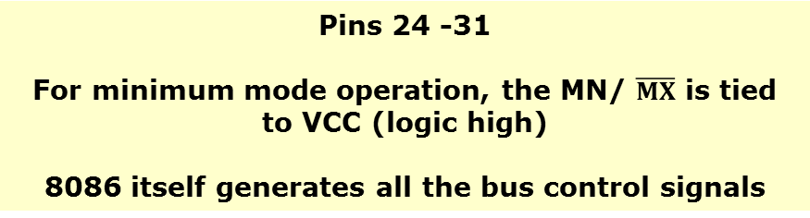

Pins and Signals
8086 Microprocessor
Minimum mode signals
Pins 24 -31
For minimum mode operation, the MN/ $\overline{MX}$ is tied to VCC (logic high)
8086 itself generates all the bus control signals
 | (Data Transmit/ Receive) This signal control the direction of data flow through the data transceivers. When it is HIGH data are sent out. When it is LOW data are received.
 | (Data Enable) Output signal from the processor used as out put enable for the transceivers.
ALE | (Address Latch Enable) Used to demultiplex the address and data lines using external latches
 | Used to differentiate memory or I/O access. When it is high the CPU wants to access memory. When it is low the CPU wants to access I/O device.
 | Write control signal. When it is low the CPU performs memory or I/O write operation.
 | (Interrupt Acknowledge) When the interrupt request is accepted by the processor, the processor issues an interrupt acknowledgement signal.

Slide 11
Pins and Signals
8086 Microprocessor
Minimum mode signals
Pins 24 -31
For minimum mode operation, the MN/ $\overline{MX}$ is tied to VCC (logic high)
8086 itself generates all the bus control signals
HOLD | Input signal to the processor from the bus masters as a request to grant the control of the bus. Usually used by the DMA controller to get the control of the bus.
HLDA | (Hold Acknowledge) Acknowledge signal by the processor to the bus master requesting the control of the bus through HOLD. The acknowledge is asserted high, when the processor accepts HOLD.

Slide 12
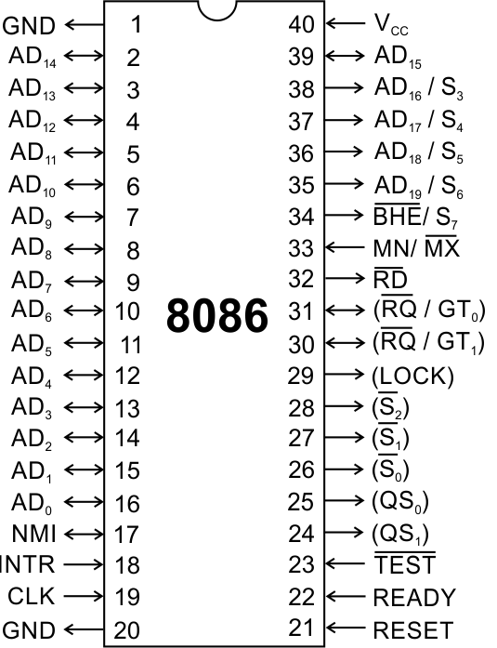
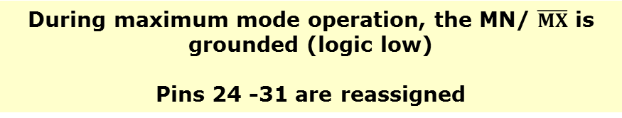
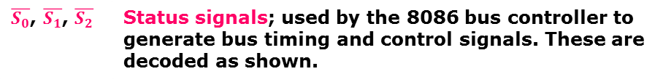
Pins and Signals
8086 Microprocessor
Maximum mode signals
During maximum mode operation, the MN/ $\overline{MX}$ is grounded (logic low)
Pins 24 -31 are reassigned
$\overline{S_{0}}$, $\overline{S_{1}}$, $\overline{S_{2}}$ | Status signals; used by the 8086 bus controller to generate bus timing and control signals. These are decoded as shown.

Slide 13
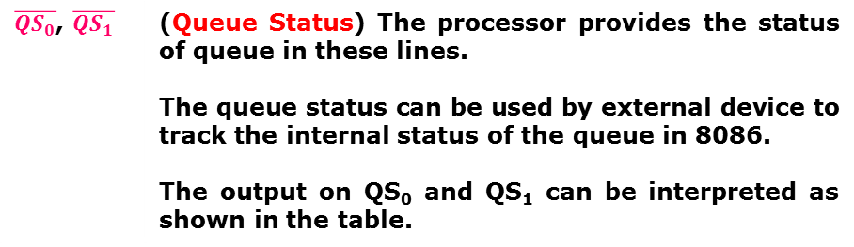
Pins and Signals
8086 Microprocessor
Maximum mode signals
During maximum mode operation, the MN/ $\overline{MX}$ is grounded (logic low)
Pins 24 -31 are reassigned
 | (Queue Status) The processor provides the status of queue in these lines. The output on QS₀ and QS₁ can be interpreted as shown in the table.

Slide 14
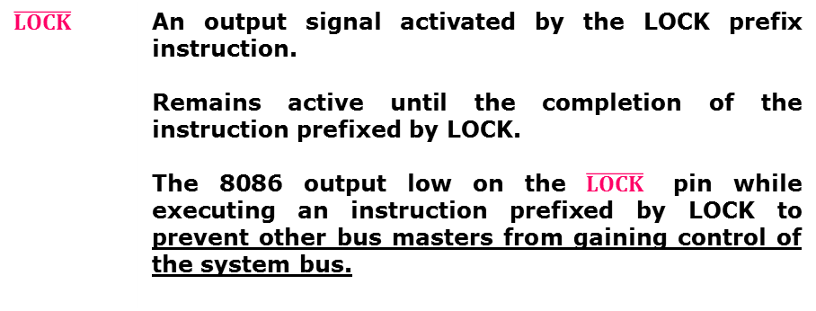
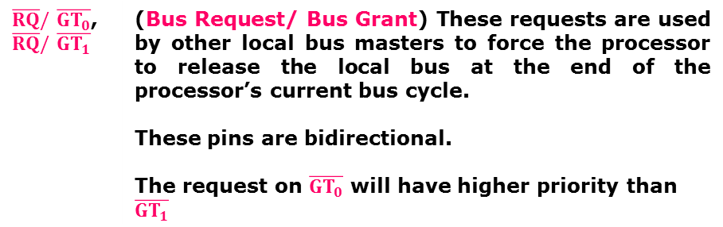
Pins and Signals
8086 Microprocessor
Maximum mode signals
During maximum mode operation, the MN/ $\overline{MX}$ is grounded (logic low)
Pins 24 -31 are reassigned
$\overline{RQ}/\overline{GT_{0}}$, $\overline{RQ}/\overline{GT_{1}}$ | (Bus Request/ Bus Grant) These requests are used by other local bus masters to force the processor to release the local bus at the end of the processor’s current bus cycle. These pins are bidirectional. The request on$\overline{GT_{0}}$ will have higher priority than$\overline{GT_{1}}$

Slide 15
Architecture

Slide 16
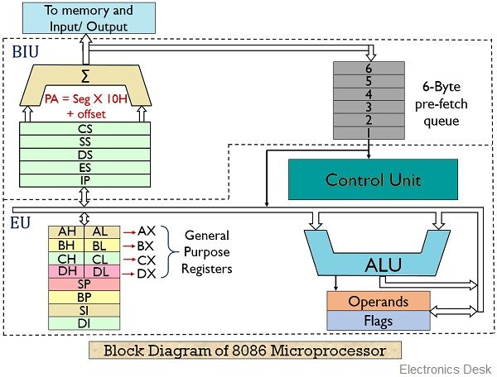

Slide 17
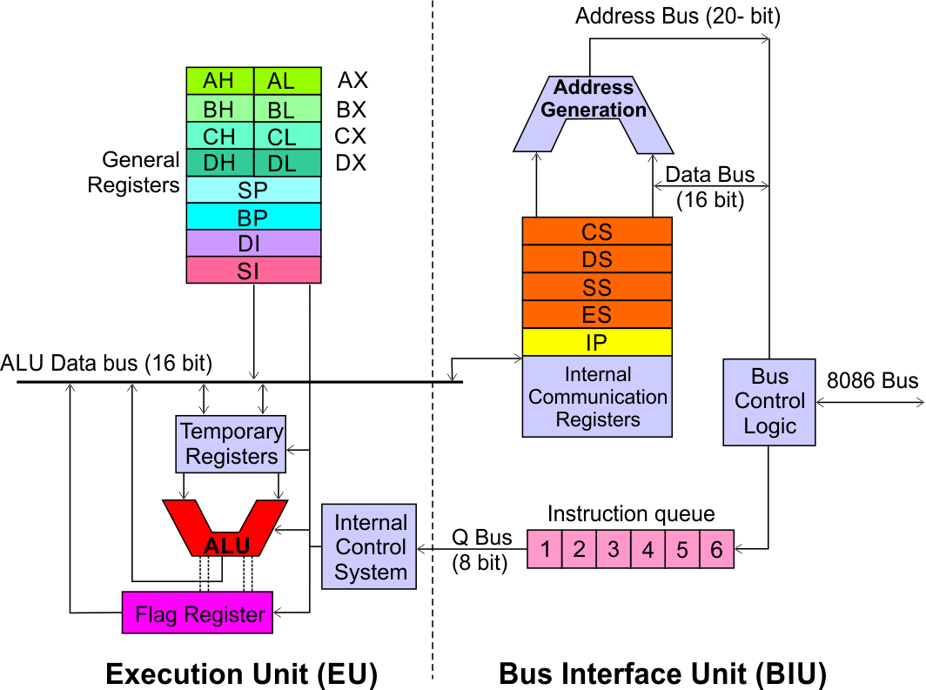
Architecture
8086 Microprocessor
Execution Unit (EU)
EU executes instructions that have already been fetched by the BIU.
BIU and EU functions separately.
Bus Interface Unit (BIU)
BIU fetches instructions, reads data from memory and I/O ports, writes data to memory and I/ O ports.

Slide 18
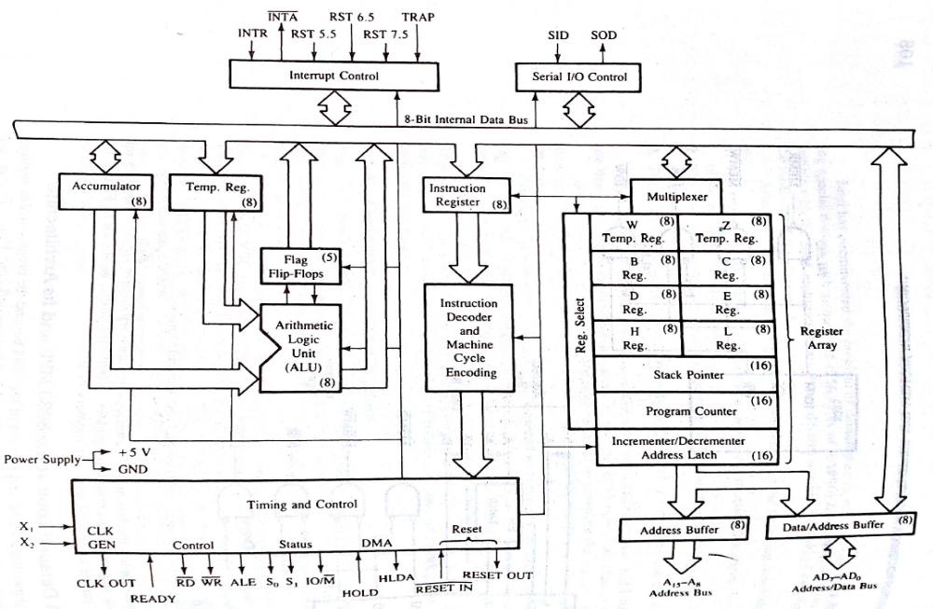

Slide 19
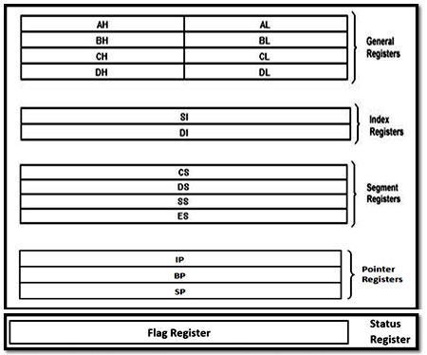
e) Status Register
Figure: Register groups of 8086 micro-processor

Slide 20
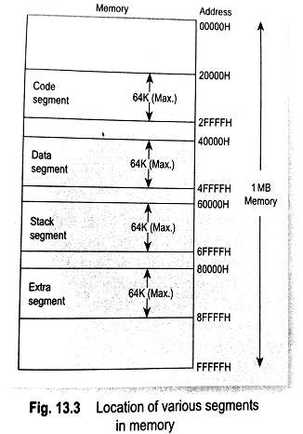

Slide 21
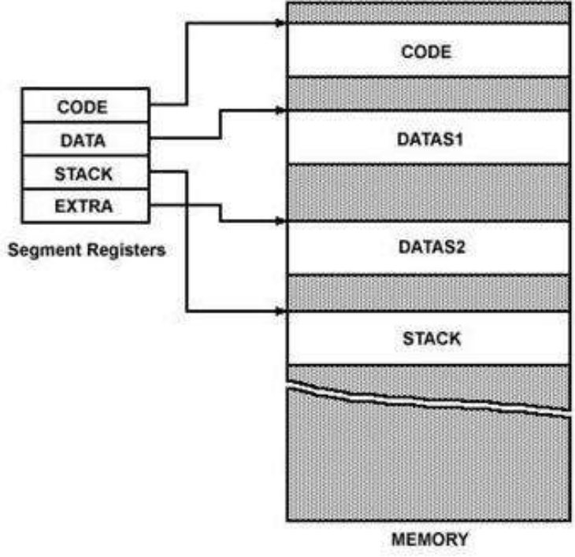

Slide 22
Pipelining:
The process of fetching the next instruction when the present instruction is being executed is called as pipelining.
Pipelining has become possible due to the use of queue.
BIU (Bus Interfacing Unit) fills in the queue until the entire queue is full.
BIU restarts filling in the queue when at least two locations of queue are vacant.
Advantages of pipelining:
The execution unit always reads the next instruction byte from the queue in BIU. This is faster than sending out an address to the memory and waiting for the next instruction byte to come.
In short pipelining eliminates the waiting time of EU and speeds up the processing. -The 8086 BIU will not initiate a fetch unless and until there are two empty bytes in its queue. 8086 BIU normally obtains two instruction bytes per fetch.

Slide 23
The Instruction Queue:
The execution unit (EU) is supposed to decode or execute an instruction.
Decoding does not require the use of buses.
When EU is busy in decoding and executing an instruction, the BIU fetches up to six instruction bytes for the next instructions.
These bytes are called as the pre-fetched bytes and they are stored in a first in first out (FIFO) register set, which is called as a queue.

Slide 24
Architecture
8086 Microprocessor
Execution Unit (EU)
EU decodes and executes instructions.
A decoder in the EU control system translates instructions.
16-bit ALU for performing arithmetic and logic operation
Four general purpose registers(AX, BX, CX, DX);
Pointer registers (Stack Pointer, Base Pointer);
and
Index registers (Source Index, Destination Index) each of 16-bits
Some of the 16 bit registers can be used as two 8 bit registers as :
AX can be used as AH and AL
BX can be used as BH and BL
CX can be used as CH and CL
DX can be used as DH and DL

Slide 25
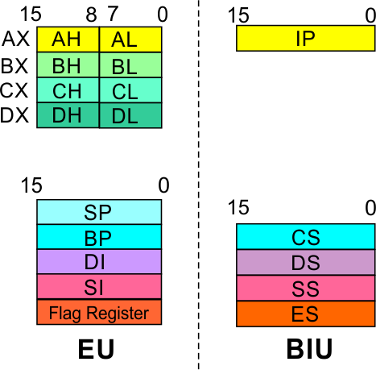
Architecture
8086 Microprocessor
Execution Unit (EU)
EU
Registers
Accumulator Register (AX)
Consists of two 8-bit registers AL and AH, which can be combined together and used as a 16-bit register AX.
AL in this case contains the low order byte of the word, and AH contains the high-order byte.
The I/O instructions use the AX or AL for inputting / outputting 16 or 8 bit data to or from an I/O port.
Multiplication and Division instructions also use the AX or AL.

Slide 26
Architecture
8086 Microprocessor
Execution Unit (EU)
EU
Registers
Base Register (BX)
Consists of two 8-bit registers BL and BH, which can be combined together and used as a 16-bit register BX.
BL in this case contains the low-order byte of the word, and BH contains the high-order byte.
This is the only general purpose register whose contents can be used for addressing the 8086 memory.
All memory references utilizing this register content for addressing use DS as the default segment register.

Slide 27
Architecture
8086 Microprocessor
Execution Unit (EU)
EU
Registers
Counter Register (CX)
Consists of two 8-bit registers CL and CH, which can be combined together and used as a 16-bit register CX.
When combined, CL register contains the low order byte of the word, and CH contains the high-order byte.
Instructions such as SHIFT, ROTATE and LOOP use the contents of CX as a counter.
Example:
The instruction LOOP START automatically decrements CX by 1 without affecting flags and will check if [CX] = 0.
If it is zero, 8086 executes the next instruction; otherwise the 8086 branches to the label START.

Slide 28
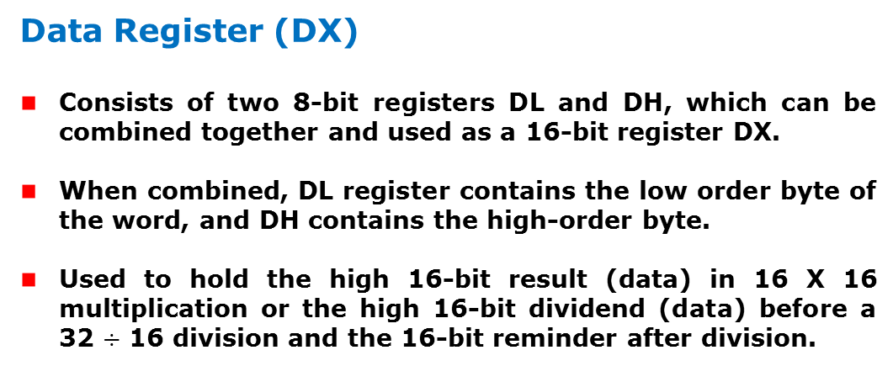
Architecture
8086 Microprocessor
Execution Unit (EU)
EU
Registers
Data Register (DX)
Consists of two 8-bit registers DL and DH, which can be combined together and used as a 16-bit register DX.
When combined, DL register contains the low order byte of the word, and DH contains the high-order byte.
Used to hold the high 16-bit result (data) in 16 X 16 multiplication or the high 16-bit dividend (data) before a 32 $÷$ 16 division and the 16-bit reminder after division.

Slide 29
Architecture
8086 Microprocessor
Execution Unit (EU)
EU
Registers
Stack Pointer (SP) and Base Pointer (BP)
SP and BP are used to access data in the stack segment.
SP is used as an offset from the current SS during execution of instructions that involve the stack segment in the external memory.
SP contents are automatically updated (incremented/ decremented) due to execution of a POP or PUSH instruction.
BP contains an offset address in the current SS, which is used by instructions utilizing the based addressing mode.

Slide 30
Architecture
8086 Microprocessor
Execution Unit (EU)
EU
Registers
Source Index (SI) and Destination Index (DI)
Used in indexed addressing.
Instructions that process data strings use the SI and DI registers together with DS and ES respectively in order to distinguish between the source and destination addresses.

Slide 31
Architecture
8086 Microprocessor
Execution Unit (EU)
EU
Registers
Source Index (SI) and Destination Index (DI)
Used in indexed addressing.
Instructions that process data strings use the SI and DI registers together with DS and ES respectively in order to distinguish between the source and destination addresses.

Slide 32
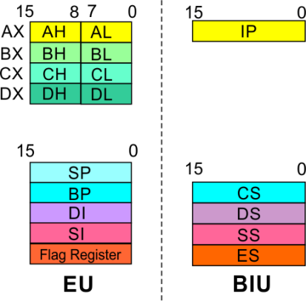
8086 Microprocessor
Architecture
8086 registers categorized into 4 groups
15 | 14 | 13 | 12 | 11 | 10 | 9 | 8 | 7 | 6 | 5 | 4 | 3 | 2 | 1 | 0
 |  |  |  | OF | DF | IF | TF | SF | ZF |  | AF |  | PF |  | CF
Sl.No. | Type | Register width | Name of register
1 | General purpose register | 16 bit | AX, BX, CX, DX
 |  | 8 bit | AL, AH, BL, BH, CL, CH, DL, DH
2 | Pointer register | 16 bit | SP, BP
3 | Index register | 16 bit | SI, DI
4 | Instruction Pointer | 16 bit | IP
5 | Segment register | 16 bit | CS, DS, SS, ES
6 | Flag (PSW) | 16 bit | Flag register

Slide 33
8086 Microprocessor
Architecture
Registers and Special Functions
Register | Name of the Register | Special Function
AX | 16-bit Accumulator | Stores the 16-bit results of arithmetic and logic operations
AL | 8-bit Accumulator | Stores the 8-bit results of arithmetic and logic operations
BX | Base register | Used to hold base value in base addressing mode to access memory data
CX | Count Register | Used to hold the count value in SHIFT, ROTATE and LOOP instructions
DX | Data Register | Used to hold data for multiplication and division operations
SP | Stack Pointer | Used to hold the offset address of top stack memory
BP | Base Pointer | Used to hold the base value in base addressing using SS register to access data from stack memory
SI | Source Index | Used to hold index value of source operand (data) for string instructions
DI | Data Index | Used to hold the index value of destination operand (data) for string operations

Slide 34
Programming Techniques: Looping, Counting and Indexing

Slide 35
Calculate the sum of series of numbers. The length of the series is in memory location 4200H and the series begins from memory location 4201H.
Consider the sum to be 8 bit number. So, ignore carries. Store the sum at memory location 4300H

Slide 36
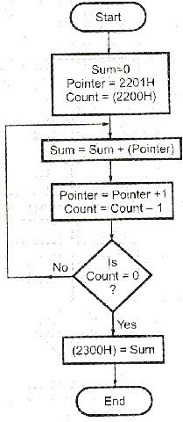
LDA 4200H :Load the no. In the Accumulator
MOV C, A : Initialize counter
SUB A : sum = 0
LXI H, 420lH : Initialize pointer
BACK: ADD M : SUM = SUM + data
INX H : increment pointer
DCR C : Decrement counter
JNZ BACK : if counter is not equal to 0 repeat
STA 4300H : Store sum
HLT : Terminate program execution

Slide 37
Write a program to count number of 1’s in given data (2000) and store the result in memory location 3000h.

Slide 38
LDA 2000H :Load No. In Acc.
MVI B,00 :B as counter with initial value 00H
MVI C,08 :C as counter for looping
BACK: RAR : Rotate the content of Acc.right with carry
JNC NEXT: if bit is not 1 go to next
INR B: if bit is 1 increment counter B
NEXT: DCR C : Decrement counter C
JNZ BACK: if C is not zero jump to BACK
MOV A,B: move the result from B to A
STA 3000: Store the result in 3000H
HLT

Slide 39
16 bytes of data are stored in memory location at xx50H to xx5FH.Transfer the entire block of data to new memory location starting at xx70H.

Slide 40
LXI H,XX50H: Initialize source memory pointer
LXI D,XX70H: Initialize Destination memory pointer
MVI B.10H: Counter to count 16 byte of data
4. MOV A,M: Get data from Source address
5. STAX D: store the data in destination Address
6. INX H
7. INX D
8. DCR B
9. JNZ 4.
10.HLT

Slide 41
Write an ALP for finding the largest number in a given series.

Slide 42
LDA 9000H //Load the length of series
MOV C,A//initialize c as counter
MVI A,00H//initialize Max=0
LXI H,9001H//initialize the memory pointer
Loop: CMP M//check if data from the series >max
JNC Next//if not jump next
MOV A,M//If it is, replace Max with the data from the series
Next: INX H
DCR C
JNZ Loop
STA 9100H
HLT

Slide 43
Sort a given list of 10 numbers starting at memory location 9000H in ascending order.

Slide 44
MVI B,09H//Initialize outer counter1
Loop2: LXI H,9000H//Initialize The memory pointer
MVI C,09H// Initialize inner counter2
Loop1: MOV A,M//Load data from series in the Accumulator
INX H
CMP M//Compare the No. with the next no. in series
JC Next//If it is lesser, do not do not interchange the no.
MOV D,M//get the data from memory to register D
MOV M,A//Move the contents of register A to memory
DCX H// Point the previous data
MOV M,D//Move the content of register D to memory
INX H//Increment pointer(Interchange of numbers complete)
Next: DCR C//Decrement inner counter2
JNZ loop1//If it is not zero, repeat the process
DCR B//decrement outer counter1
JNZ loop2//if it is zero jump to loop2
HLT

Slide 45
Delays
Each instruction passes through different combinations of Fetch, Memory Read, and Memory Write cycles.
Knowing the combinations of cycles, one can calculate how long such an instruction would require to complete.
  B for Number of Bytes
  M for Number of Machine Cycles
  T for Number of T-State.
*

Slide 46
Delays
Knowing how many T-States an instruction requires, and keeping in mind that a T-State is one clock cycle long, we can calculate the time using the following formula:
Delay = No. of T-States / Frequency
For example a “MVI” instruction uses 7 T-States. Therefore, if the Microprocessor is running at 2 MHz, the instruction would require 3.5 μSeconds to complete.
*

Slide 47
Delay loops
We can use a loop to produce a certain amount of time delay in a program.
The following is an example of a delay loop:
MVI C, FFH 7 T-States
LOOP:DCR C 4 T-States
JNZ LOOP 10 T-States
The first instruction initializes the loop counter and is executed only once requiring only 7 T-States.
The following two instructions form a loop that requires 14 T-States to execute and is repeated 255 times until C becomes 0.
*

Slide 48
Delay Loops
We need to keep in mind though that in the last iteration of the loop, the JNZ instruction will fail and require only 7 T-States rather than the 10.
Therefore, we must deduct 3 T-States from the total delay to get an accurate delay calculation.
To calculate the delay, we use the following formula:
T_{delay} = T_{O} + T_{L}
  T_{delay} = total delay
  T_{O} = delay outside the loop
  T_{L} = delay of the loop
T_{O} is the sum of all delays outside the loop.
T_{L} is calculated using the formula
  T_{L} = T X Loop T-States X N₁₀
*

Slide 49
Delay Loops
Using these formulas, we can calculate the time delay for the previous example:
T_{O} = 7 T-States
  Delay of the MVI instruction
T_{L} = (14 X 255) - 3 = 3567 T-States
  14 T-States for the 2 instructions repeated 255 times
  (FF₁₆ = 255₁₀) reduced by the 3 T-States for the final JNZ.
T_{Delay} = (7 + 3567) X 0.5 μSec = 1.787 mSec
  Assuming f = 2 MHz
*

Slide 50
Using a Register Pair as a Loop Counter
Using a single register, one can repeat a loop for a maximum count of 255 times.
It is possible to increase this count by using a register pair for the loop counter instead of the single register.
  A minor problem arises in how to test for the final count since DCX and INX do not modify the flags.
  However, if the loop is looking for when the count becomes zero, we can use a small trick by ORing the two registers in the pair and then checking the zero flag.
*

Slide 51
Using a Register Pair as a Loop Counter
The following is an example of a delay loop set up with a register pair as the loop counter.
LXI B, 1000H 10 T-States
LOOP DCX B 6 T-States
MOV A, C 4 T-States
ORA B 4 T-States
JNZ LOOP 10 T-States
*

Slide 52
Using a Register Pair as a Loop Counter
Using the same formula from before, we can calculate:
T_{O} = 10 T-States
  The delay for the LXI instruction
T_{L} = (24 X 4096) - 3 = 98301 T- States
  24 T-States for the 4 instructions in the loop repeated 4096 times (1000₁₆ = 4096₁₀) reduced by the 3 T-States for the JNZ in the last iteration.
T_{Delay} = (10 + 98301) X 0.5 µSec = 49.155 mSec
*

Slide 53
Nested Loops
Nested loops can be easily setup in Assembly language by using two registers for the two loop counters and updating the right register in the right loop.
  In the figure, the body of loop2 can be before or after loop1.
Initialize loop 2
Body of loop 2
Initialize loop 1
Body of loop 1
Update the count1
No
Is this
Final
Count?
Yes
Update the count 2
No
Is this
Final
Count?
Yes
*

Slide 54
Nested Loops for Delay
Instead Register Pairs, a nested loop structure can be used to increase the total delay produced.
MVI B, 10H 7 T-States
LOOP2 MVI C, FFH 7 T-States
LOOP1 DCR C 4 T-States
JNZ LOOP1 10 T-States
DCR B 4 T-States
JNZ LOOP2 10 T-States
*

Slide 55
Delay Calculation of Nested Loops
The calculation remains the same except that it the formula must be applied recursively to each loop.
  Start with the inner loop, then plug that delay in the calculation of the outer loop.
Delay of inner loop
  T_{O1} = 7 T-States
    MVI C, FFH instruction
  T_{L1} = (255 X 14) - 3 = 3567 T-States
    14 T-States for the DCR C and JNZ instructions repeated 255 times (FF₁₆ = 255₁₀) minus 3 for the final JNZ.
  T_{LOOP1} = 7 + 3567 = 3574 T-States
*

Slide 56
Delay Calculation of Nested Loops
Delay of outer loop
  T_{O2} = 7 T-States
    MVI B, 10H instruction
  T_{L2} = (16 X (14 + 3574)) - 3 = 57405 T-States
    14 T-States for the DCR B and JNZ instructions and 3574
    T-States for loop1 repeated 16 times (10₁₆ = 16₁₀) minus 3 for the final JNZ.
  T_{Delay} = 7 + 57405 = 57412 T-States
Total Delay
  T_{Delay} = 57412 X 0.5 μSec = 28.706 mSec
*

Slide 57
Increasing the delay
The delay can be further increased by using register pairs for each of the loop counters in the nested loops setup.
It can also be increased by adding dummy instructions (like NOP) in the body of the loop.
*

Slide 58
Write a program to generate a delay of 0.4 sec if the crystal frequency is 5MHz
Operating frequency is half of crystal frequency 2.5MHz
Delay = No. of T-States / Frequency
No. of T-States= Delay × Frequency
= 0.4 × 2.5MHZ
=1000000

Slide 59
LXI B, n (Count) (10T States)
BACK: DCX B (6T States)
MOVA,C (4T States)
ORA B (4T States)
JNZ BACK (10T States)
Total T states= 10T + (24×n -3)T= 1000000T
After solving n= (41666)D = (A2C2)H

